Slide 1
GLOBAL CONTROL BASE STRATEGY FOR CAMPAIGN efficacy MEASUREMENT
MAY 2017
PLATFORM ANALYTICS

Slide 2

BACKGROUND
Objective:
Gap Inc. acquires millions of new customers every year over multiple brands across diverse geographies
Customer profile is diverse in terms of their life stage, shopping preference , communication preference etc
Universal control base for marketing test measurement is necessary
It has to be representative of the overall customer base
The whole strategy will help in:
Unify the campaign lift measurement
Lift measured is always correct as control base customers are not sent any promotional message from any of the Gap Inc team

Slide 3

PRESENT STATE OF CONTROL BASE SELECTION
Marketing Communications
Identified Issues:
No true control group
Bias due to overlap of test and control (campaign control for one may be test at the same time for different campaign)
True efficacy and campaign uplift measurement is impossible
Attrition Campaign
Email Campaign
DM Campaign
Total Customer Targeted
Additional Revenue
Campaign Lift
Control
Control
Marketing Filters
Control
Measurement Metrics

Slide 4

SOUTION: CREATE GLOBAL CONTROL BASE
Overall Customer Base
Marketing Communications
Universal Control Group
Test Group
Attrition Campaign
Email Campaign
DM Campaign
Total Customer Targeted
Additional Revenue
Campaign Lift
NO Campaign
Benefits:
Universal Control , so minimal skewedness
Able to calculate true efficacy of the campaign
Measurement Metrics

Slide 5
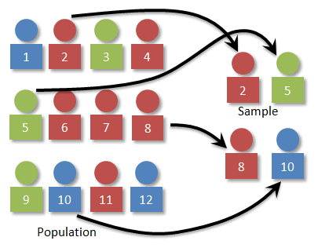
TECHNIQUES TO CREATE GLOBAL CONTROL BASE
Stratified Sampling
Maintain population characteristics to the sample selected
Sample Selection Process :
Pick stratified sample from active customer base at the start of the quarter (cadence)
Every month/week use the same process to pick up incremental sample of same proportion from incremental base
Proportion to be ratified from business as how much of the base they can sacrifice for not having campaign
Repeat the same process after the start of the next quarter (cadence)
MoM/WoW incremental sampling will ensure the seasonal character of customer acquisition is taken care of
Variable to be used for stratification:
Brand
Age (Young / Middle Aged / Seniors)
Vintage of Customers (1 year/ 2 year/ 3+ year etc)
Channel Use (Online/ Retail/ Multichannel)
Platform Usage for browse (Mobile/ Computer )
Annual purchase buckets (High/Medium/Low)
Channel Preference and completeness for contact
Loyalty card type
Many other attributes can also be added

Slide 6
CAMPAIGN PROCESS TO FACTOR GLOBAL CONTROL
Campaign Measurement Metrics
Lift
Gain
ROI
Incremental Response
etc
Overall Target Base
Campaign Filters
Customers matching with global control
Final Campaign Base
Global Control Base
Campaign Control Base

Slide 7
Thank you

